Slide 1


Nishant Medpalwar 06.08.2023

Slide 2
Outline
Executive Summary
Introduction
Methodology
Results
Conclusion
Appendix

Slide 3
Executive Summary
Used methodologies:
Data collection using SpaceX API and web scraping
Exploratory Data Analysis, including data wrangling, data visualization and creating interactive dashboard
Predictive analysis using machine learning algorithms
Summary of all results:
EDA identified the best features to predict the success of launchings
Machine learning prediction found the models with relatively high accuracy

Slide 4
Introduction
The objective is to evaluate the competitiveness of the new rocket company Space Y with SpaceX
Desirable outcome:
the best way to estimate the cost of launch, by predicting if the first stage of the rocket will be reused

Slide 5

Section 1
5

Slide 6
Methodology
Executive Summary
Data collection methodology:
Data was collected from 2 sources:
SpaceX API (https://api.spacexdata.com/v4/rockets/)
Wikipedia web scraping (https://en.wikipedia.org/wiki/List_of_Falcon/_9/_and_Falcon_Heavy_launches)
●
Perform data wrangling
The data was enhanced by creating a landing outcome label based on the Outcome data and preceding feature analysis
Perform exploratory data analysis (EDA) using visualization and SQL

Slide 7
Methodology
Executive Summary
Perform interactive visual analytics using Folium and Plotly Dash
Perform predictive analysis using classification models
Collected data was standardized, splitted into train and test sets and evaluated by four different classification models. The best combination of hyperparameters for each model was found by Grid Search and then the accuracies were computed and compared.

Slide 8
Data Collection
Data sets were collected from 2 sources:
SpaceX API (https://api.spacexdata.com/v4/rockets/)
Wikipedia web scraping (https://en.wikipedia.org/wiki/List_of_Falcon/_9/_and_Falcon_Heavy_launches)

Slide 9
Data Collection – SpaceX API
SpaceX offers API where the data can be obtained from
Request and parse the SpaceX launch data using the GET request
Flowchart shows data collection with SpaceX REST calls
Filter the dataframe to only include Falcon 9 launches
Dealing with missing values
Source code:
https://github.com/Nishn3/Data-science-capstone-space-x-falcon-9/blob/main/Data_Collection_API.ipynb
9

Slide 10
Data Collection - Scraping
SpaceX data can also be obtained from Wikipedia
Request the Falcon 9 Launch Wiki page using the GET request
Flowchart shows data collection and manipulation from Wikipedia
Extract all column / variable names from the HTML table header
Create a dataframe by parsing the launch HTML tables
Source code:
https://github.com/Nishn3/Data-science-capstone-space-x-falcon-9/blob/main/Webscraping.ipynb
10

Slide 11
Data Wrangling
Initial Exploratory Data Analysis was performed on the dataset
Performed summarizations - number of launches per site, occurrences of each orbit, occurrences of mission outcome per orbit
The landing outcome label was created based on Outcome column
EDA
Summarizations
Landing outcome label
Source code:
https://github.com/Nishn3/Data-science-capstone-space-x-falcon-9/blob/main/Data_Wrangling.ipynb

Slide 12
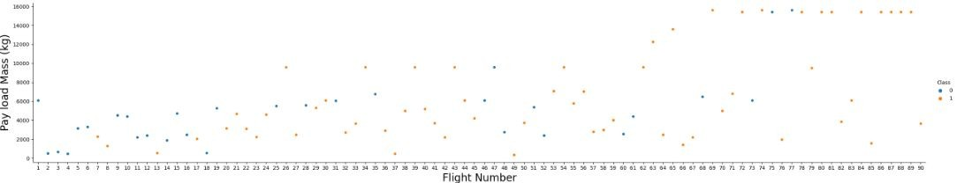
EDA with Data Visualization
The following charts were used for further analysis and visualization of relationship between the pairs of features:
scatterplot - Flight Number vs. Payload Mass, Flight Number vs. Launch Site, Payload Mass vs. Launch Site, Flight Number vs. Orbit type, Payload Mass vs. Orbit Type
bar chart - Orbit Type vs. Success Rate
Source code:
https://github.com/Nishn3/Data-science-capstone-space-x-falcon-9/blob/main/Data_Vizualisation.ipynb

Slide 13
EDA with SQL
The following SQL queries were performed and displayed:
Names of the unique launch sites in the space mission
Top 5 launch sites begin with the string ‘CCA’
Total payload mass carried by boosters launched by NASA (CRS)
Average payload mass carried by booster version F9 v1.1
Date when the first successful landing outcome in ground pad was achieved
Names of the boosters which have success in drone ship and have payload mass greater than 4000 but less than 6000
Total number of successful and failure mission outcomes
Names of the booster versions which have carried the maximum payload mass
Failure landing outcomes in drone ship and their booster versions, launch site names in year 2015
Rank of the count of successful landing outcomes between the date 04-06-2014 and 20-03-2017 in descending order
Source code:https://github.com/Nishn3/Data-science-capstone-space-x-falcon-9/blob/main/EDA_SQL.ipynb
13

Slide 14
Build an Interactive Map with Folium
Markers, marker clusters, circles and lines were added to a Folium map
Markers indicate coordinates / points (like launch sites)
Marker clusters indicate a group of markers with the same specific characteristic (like markers having the same coordinate)
Circles indicate an highlighted area around a specific coordinate (like NASA Johnson Space Center)
Lines indicate the distance between two coordinates
Source code:https://github.com/Nishn3/Data-science-capstone-space-x-falcon-9/blob/main/Launch_Site_Location_Folium.ipynb
14

Slide 15
Build a Dashboard with Plotly Dash
Following graphs were used:
pie chart to show the total successful launches for all sites
a slider to select of payload range
scatter plot to show the correlation between the payload and launch success for each site
Source code:https://github.com/Nishn3/Data-science-capstone-space-x-falcon-9/blob/main/spacex_dash_app.py
15

Slide 16
Predictive Analysis (Classification)
Four classification models were used for predictive analysis: Logistic regression, SVM, Decision tree classifier, k Nearest neighbors
The best combination of hyperparameters for each model was found by Grid Search
Training each model with combinations of hyperparameters using Grid Search
Data preparation and standardization
Comparison of results
Source code:https://github.com/Nishn3/Data-science-capstone-space-x-falcon-9/blob/main/Machine_Learning_Prediction.ipynb
16

Slide 17
Results
Exploratory Data Analysis results:
SpaceX uses 4 launch sites
Average payload mass carried by booster version F9 v1.1 was 2928 kg
The first successful landing outcome in ground pad was achieved in 2017
Almost 100% of mission outcomes were successful

Slide 18
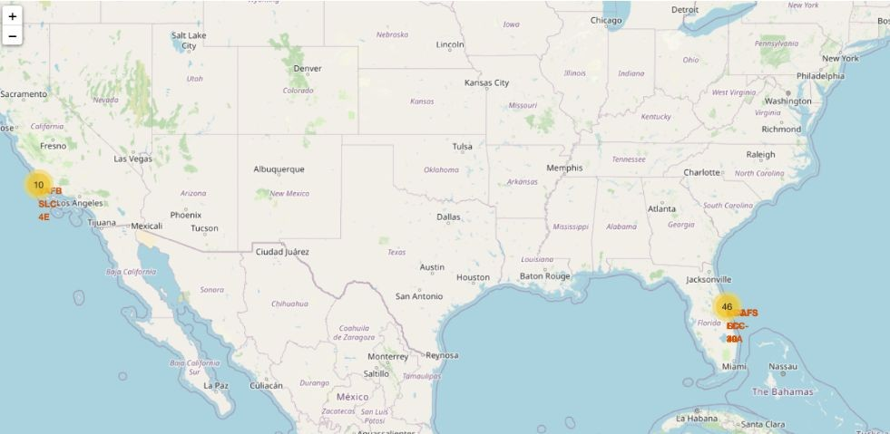
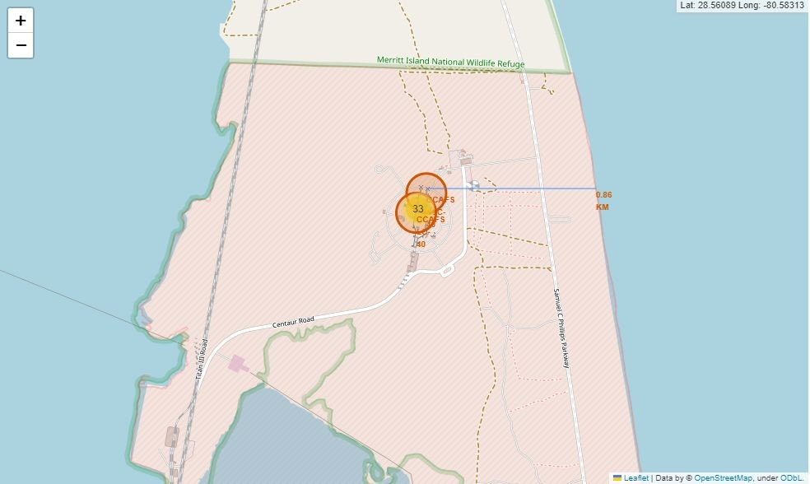
Results
Using interactive analytics was possible to identify the locations of launch sites
They are usually located near the sea with a good logistic infrastructure around

Slide 19
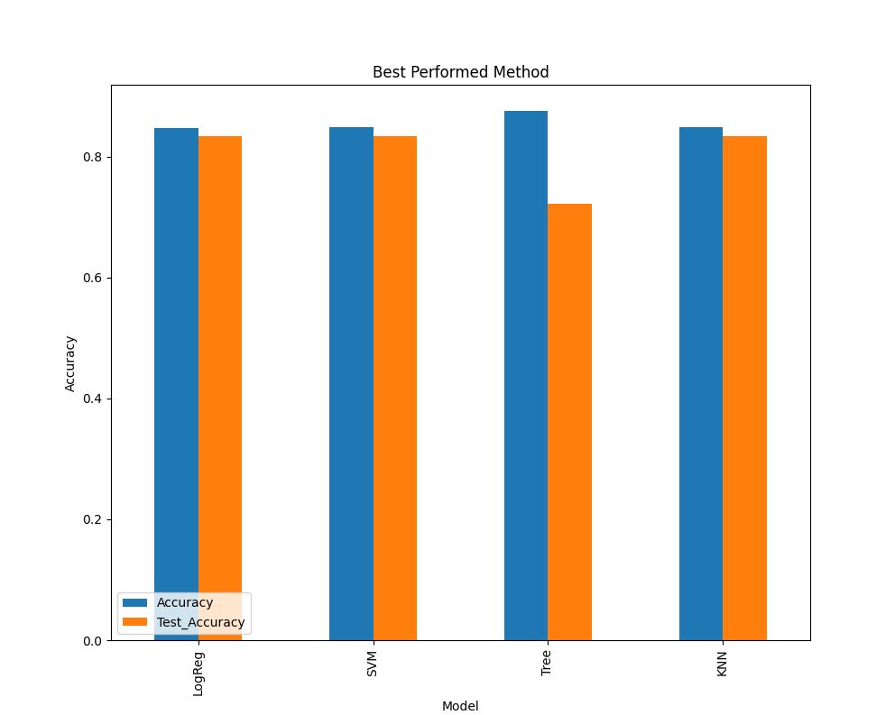
Results
Predictive analysis showed that Logistic regression, SVM and k Nearest neighbors produced similar results with accuracy rate of about 83.33%
More data is needed for better model determination and accuracy

Slide 20

Section 2

Slide 21
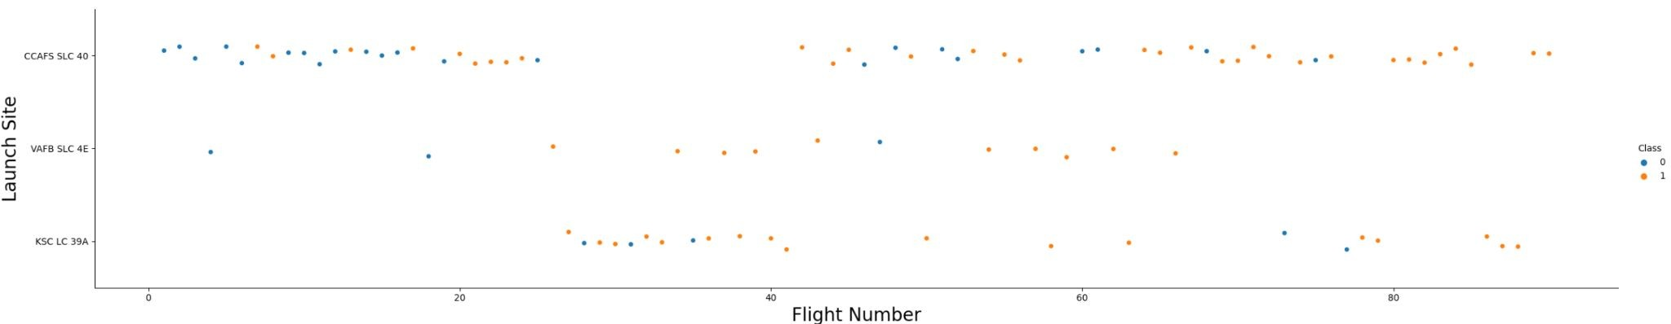
Flight Number vs. Launch Site
The higher the flight number, the higher chance of successful landing of the rocket’s first stage
The most successful launch site is CCAFS SLC 40

Slide 22
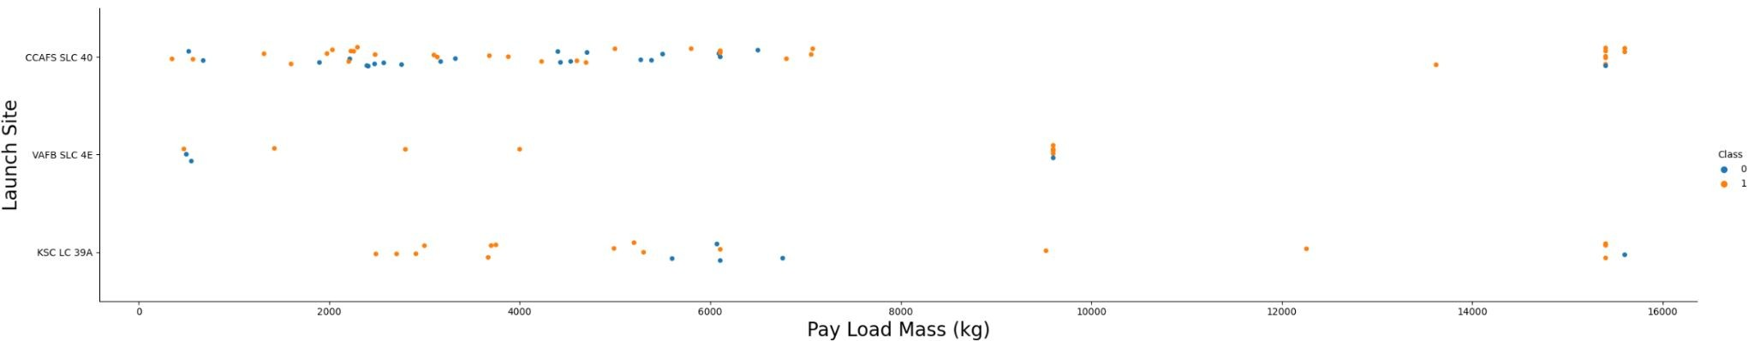
Payload vs. Launch Site
VAFB-SLC 4E : no rockets launched with payload mass greater than 10000 kg
Payloads over 9000 kg have high success rate

Slide 23
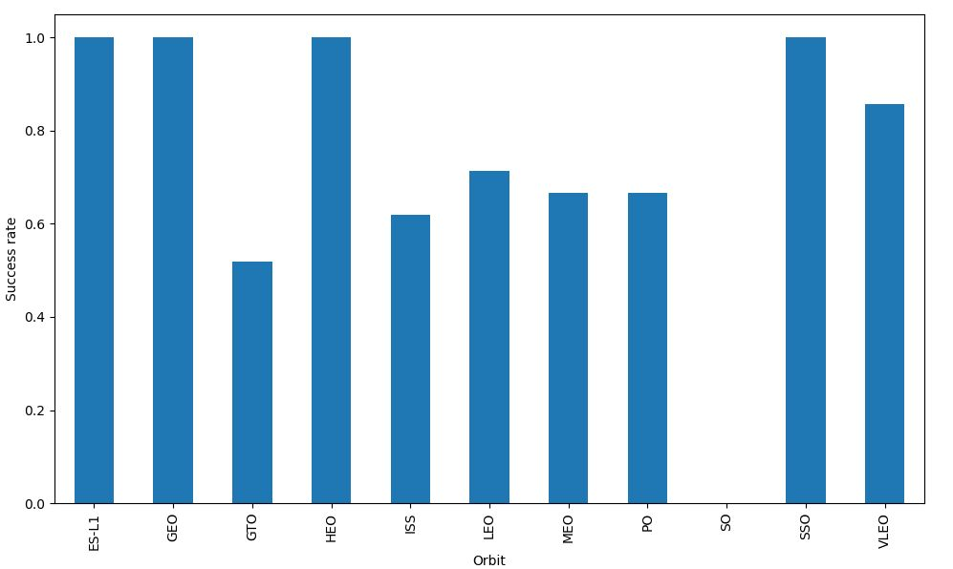
Success Rate vs. Orbit Type
the highest success rate : ES-L1, GEO, HEO, SSO orbits
no success rate - SO orbit

Slide 24
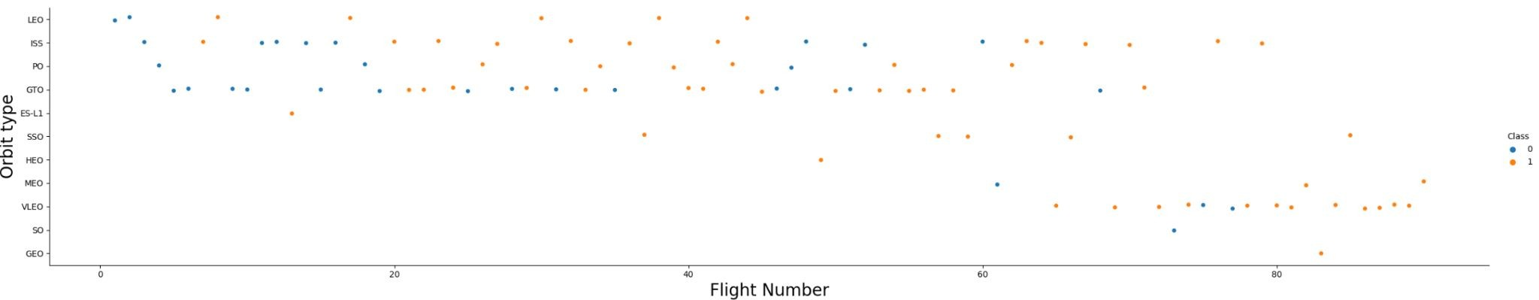
Flight Number vs. Orbit Type
LEO orbit : strong relation to the number of flights
GTO orbit : no relation
in general, success rate improved for almost all orbits

Slide 25
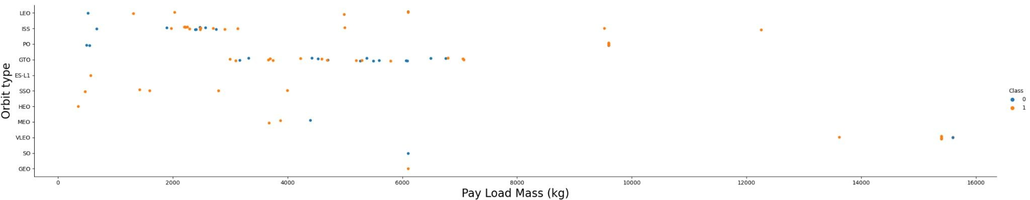
Payload vs. Orbit Type
GTO : no relation between payload and success rate
SO, GEO : only few records
ISS, PO, LEO : high success rate for heavy payloads

Slide 26
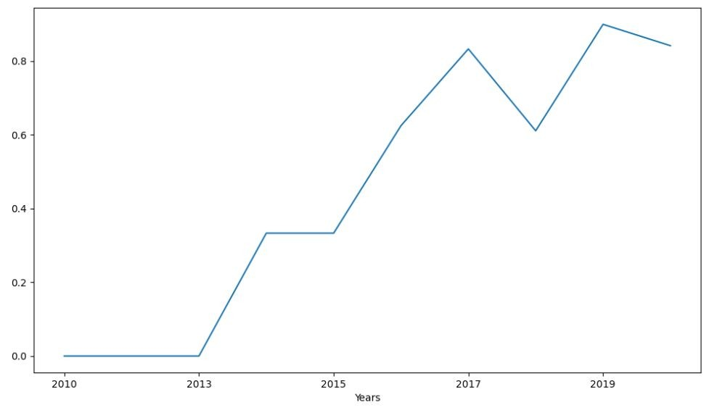
Launch Success Yearly Trend
The success rate kept increasing since 2013 till 2020
A slight fall in 2018

Slide 27
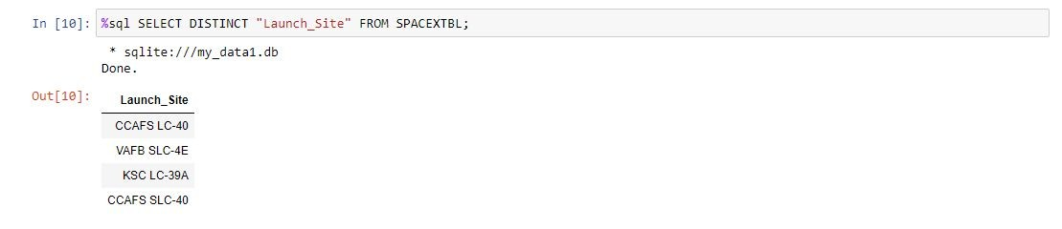
All Launch Site Names
Find the names of the unique launch sites

Slide 28
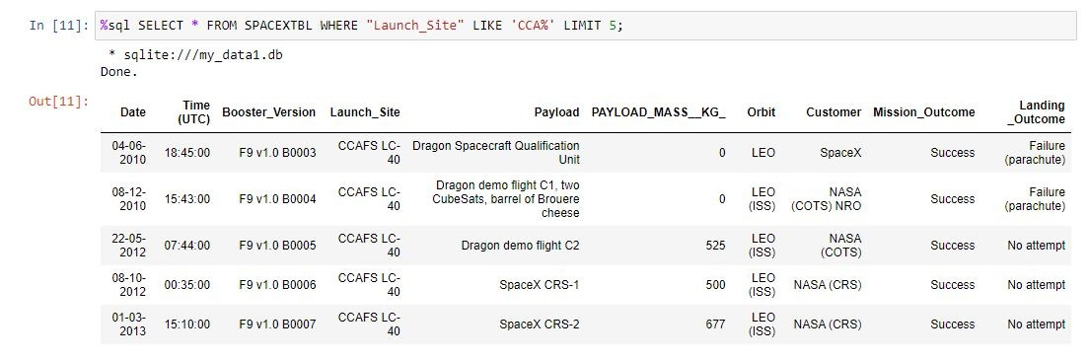
Launch Site Names Begin with 'CCA'
Find 5 records where launch sites begin with `CCA`

Slide 29
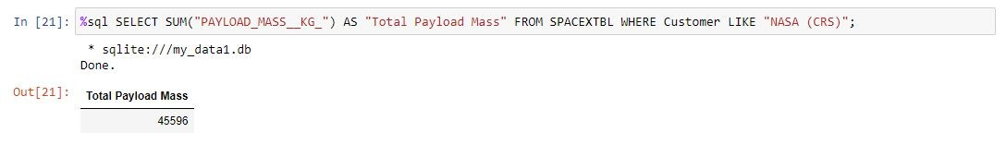
Total Payload Mass
Calculate the total payload carried by boosters from NASA (CRS)

Slide 30
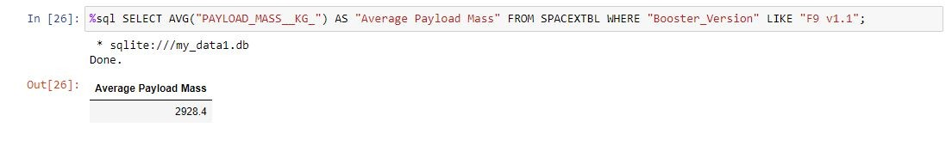
Average Payload Mass by F9 v1.1
Calculate the average payload mass carried by booster version F9 v1.1

Slide 31
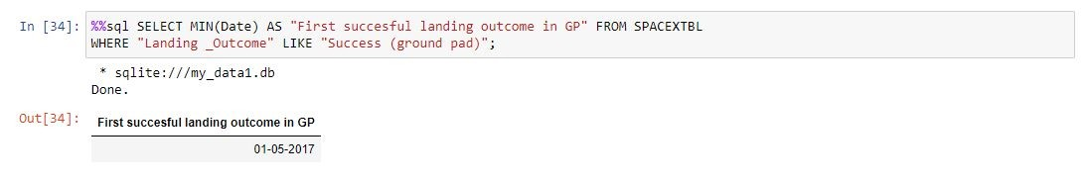
First Successful Ground Landing Date
Find the dates of the first successful landing outcome on ground pad

Slide 32
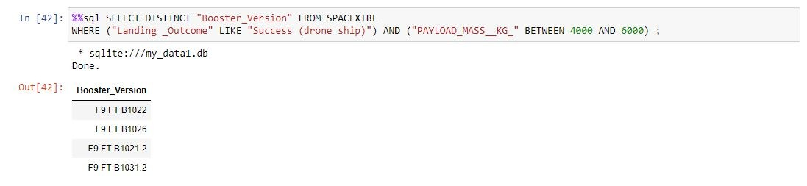
Successful Drone Ship Landing with Payload between 4000 and 6000
List the names of boosters which have successfully landed on drone ship and had payload mass greater than 4000 but less than 6000

Slide 33
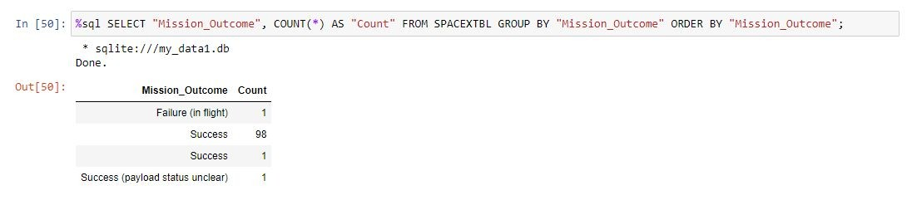
Total Number of Successful and Failure Mission Outcomes
Calculate the total number of successful and failure mission outcomes

Slide 34
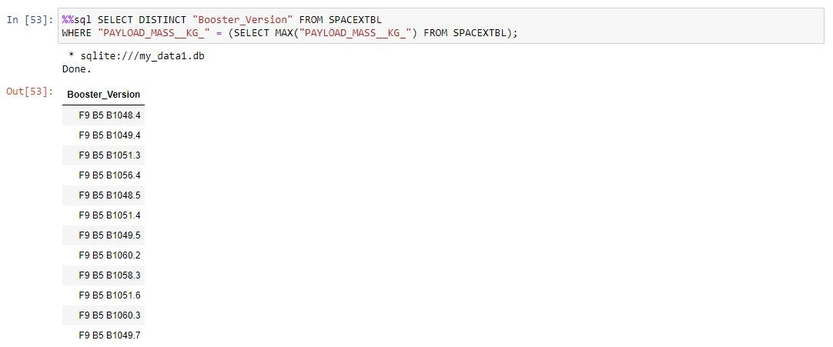
Boosters Carried Maximum Payload
List the names of the booster which have carried the maximum payload mass

Slide 35
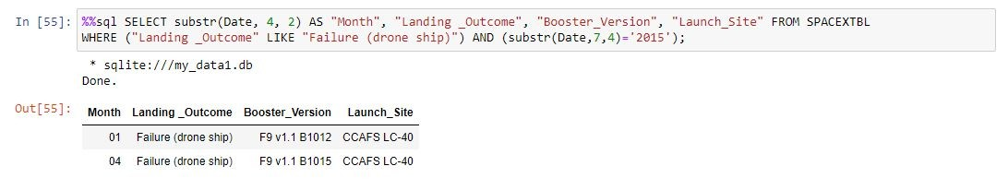
2015 Launch Records
List the failed landing_outcomes in drone ship, their booster versions, and launch site names for in year 2015

Slide 36
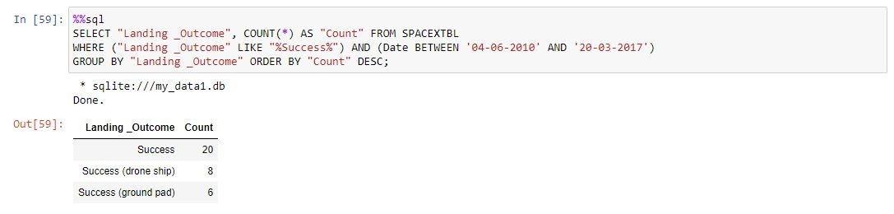
Rank Landing Outcomes Between 2010-06-04 and 2017-03-20
Rank the count of successful landing outcomes between the date 2010-06-04 and 2017-03-20, in descending order

Slide 37

Section 3

Slide 38

Launch sites
All launch sites are located close to the sea, probably for safety reasons

Slide 39
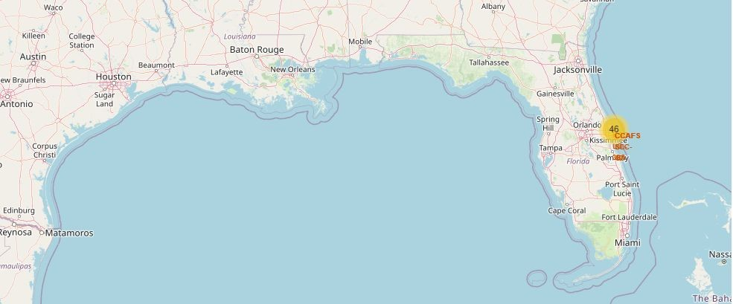
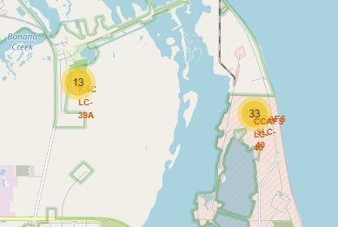
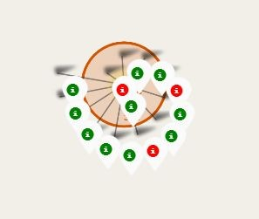
Launches for each site
example of KSC LC-39A launch site
green markers indicate successful launches, red indicates failed launches

Slide 40
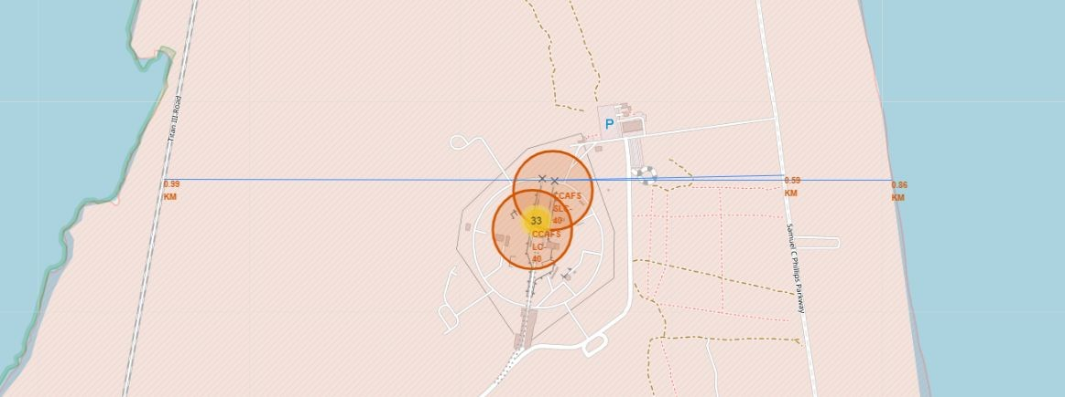
Launch sites proximities
picture shows that launch sites are located close to the railway, highway and
the coastline

Slide 41

Section 4

Slide 42
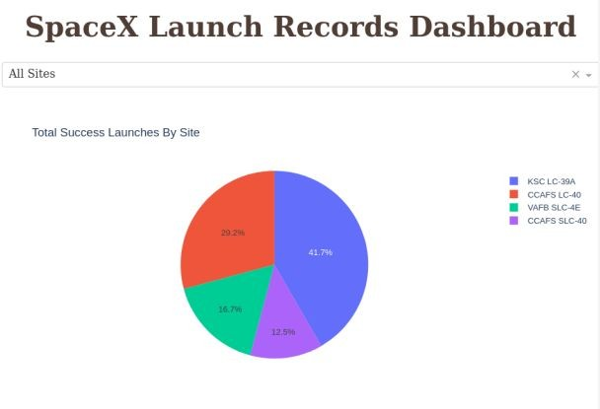
Total successful launches by site
seems that the location of launch site has an impact on the success of a mission

Slide 43
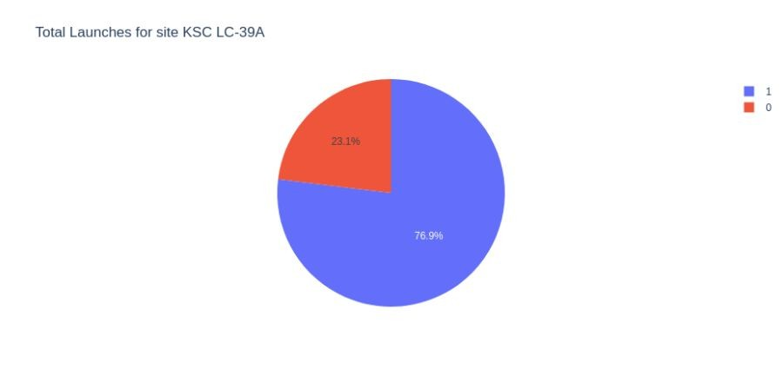
Launch site with the highest success ratio
76.9% of launches are successful for KSC LC-39A

Slide 44
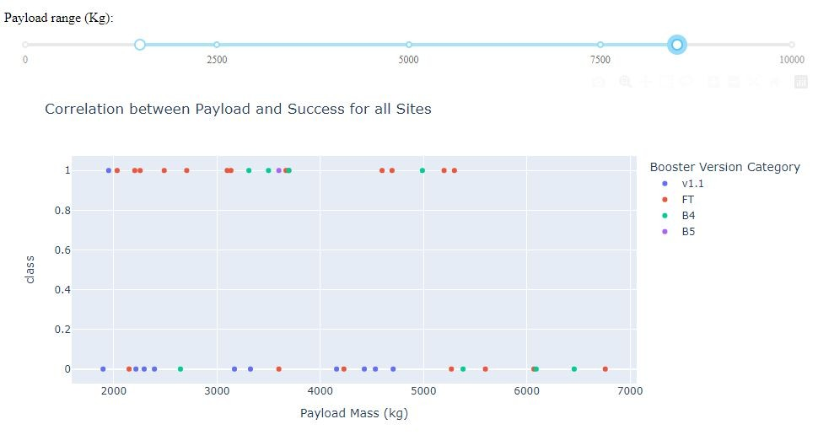
Payload vs. Launch Outcome
Payloads under 5500 kg are likely to be successful for FT boosters
Payloads under 5000 kg are likely to be unsuccessful for v1.1 boosters

Slide 45

Section 5

Slide 46
Classification Accuracy
Four classification models were trained
Logistic regression, SVM and k Nearest neighbors produced similar results with accuracy rate of about 83.33% on test set
More data is needed for better determination of the best model

Slide 47
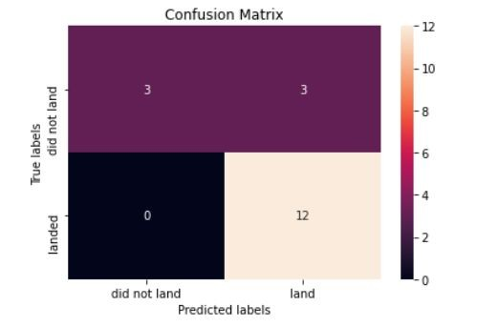
Confusion Matrix
Same matrix for Logistic Regression, SVM and KNN
Correct predictions on diagonal: top left - bottom right
Predictions:
12 true positive
3 true negative
3 false positive
0 false negative

Slide 48
Conclusions
The most successful launch site is KSC LC-39A
Payloads over 9000 kg have high success rate
Successful landing outcomes improved over the time
We created three machine learning models with an accuracy of 83.33%
They can be used to predict with a relatively high accuracy whether the first stage of the rocket will land successfully
More data is needed for better model determination and accuracy improvement

Slide 49


